Slide 1





Security Service
Management System
Proposal Presentation
ITP24R_B1_W22
16 August 2024
ITP24R_B1_W22

Slide 2
Company Background
Rakna Arakshaka Lanka Ltd (RALL) is a leading security service provider known for delivering reliable and professional security solutions.
Specializing in on-site guards and event security, RALL aims to enhance its operational efficiency and service quality through a new Security Service Management System.
ITP24R_B1_W22

Slide 3
Problem and Motivation
Current security service management approaches often face inefficiencies in recruitment, employee management, client interactions, and resource allocation.
These problem can cause delays and make operations less efficient.
ITP24R_B1_W22

Slide 4
Aim
The aim of our Security Service Management System is to streamline and automate the management of security services, enhancing efficiency across recruitment, employee management, client interactions, and operational functions, while integrating booking, training, and inventory management.
ITP24R_B1_W22

Slide 5
Objectives
Recruitment Process Management
Comprehensive Client Management
Efficient Operations Management
Integrated Booking Management
Enhanced Inventory and Supplier Management
Streamlined Payment Management
Customizable Training Management
ITP24R_B1_W22

Slide 6


Literature Review
Functions | Our App | TechCERT | NobleProg | Gajashakthi
Employee Management
Training Management
Client Management
Operation Management
Booking Management
Payment Management
Inventory Management
Supplier Management
ITP24R_B1_W22

Slide 7
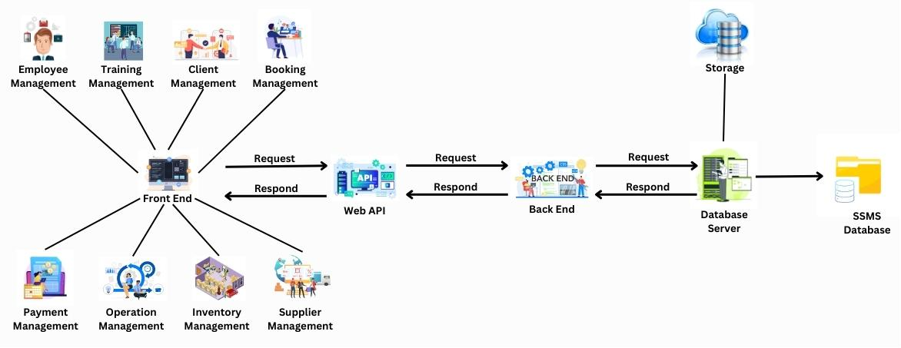
System Overview
In accordance with the Diagram below, this system has primary interaction with users and a backend.
ITP24R_B1_W22

Slide 8

SYSTEM FUNCTIONS
ITP24R_B1_W22

Slide 9

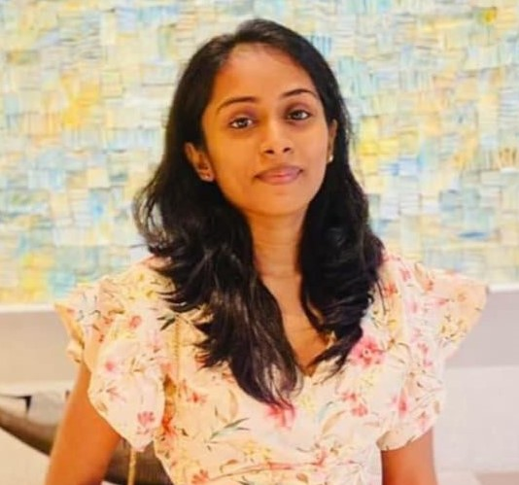
Employee Management
Name: Fernando K K C
Student ID: IT22325228
ITP24R_B1_W22

Slide 10
Employee Management
Functional Requirements
Employee Recruitment
User Access Control
Employee Information Management
Leave Management
IT22325228 | Fernando K K C

Slide 11
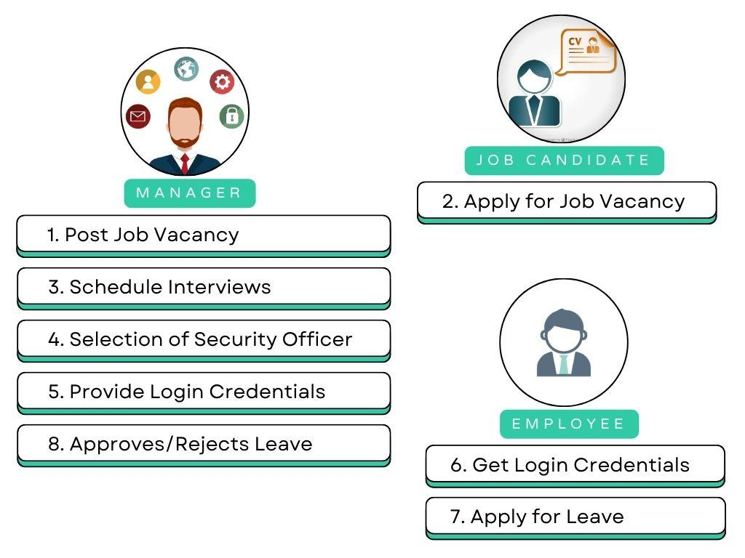
Employee Management
Process Overview
IT22325228 | Fernando K K C

Slide 12
Employee Management
Non-Functional Requirements
Security
Performance
Usability
Flexible
Maintainable
Recoverable
IT22325228 | Fernando K K C

Slide 13
Employee Management
Evaluation Methods
Tracking Applicants
Candidates Experience
Access Control
Password and Login Security
Notification and Reminders
IT22325228 | Fernando K K C

Slide 14

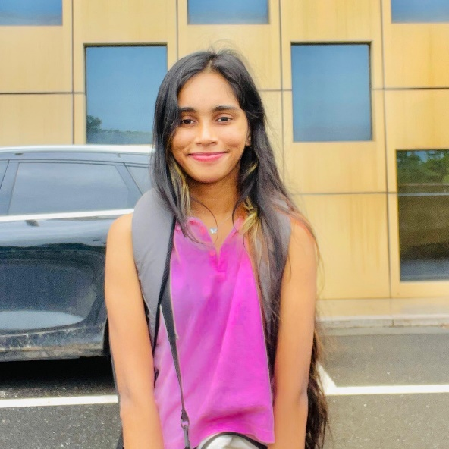
Training Management
Name: Sadisha R. M. M
Student ID: IT22907998
ITP24R_B1_W22

Slide 15
Training Management
Functional Requirements
Course Management
Training Schedule Management
IT22907998 | Sadisha R. M. M

Slide 16


Training Management
Process Overview
Training Manager
Employee/Security Officer
Course Management
Training Schedule Management
Complete the courses.
IT22907998 | Sadisha R. M. M

Slide 17
Training Management
Non-Functional Requirements
Security
Performance
Usability
Reliability
Scalability
Compliance
IT22907998 | Sadisha R. M. M

Slide 18
Training Management
Evaluation Methods
Performance Metrics
System Testing
IT22907998 | Sadisha R. M. M

Slide 19

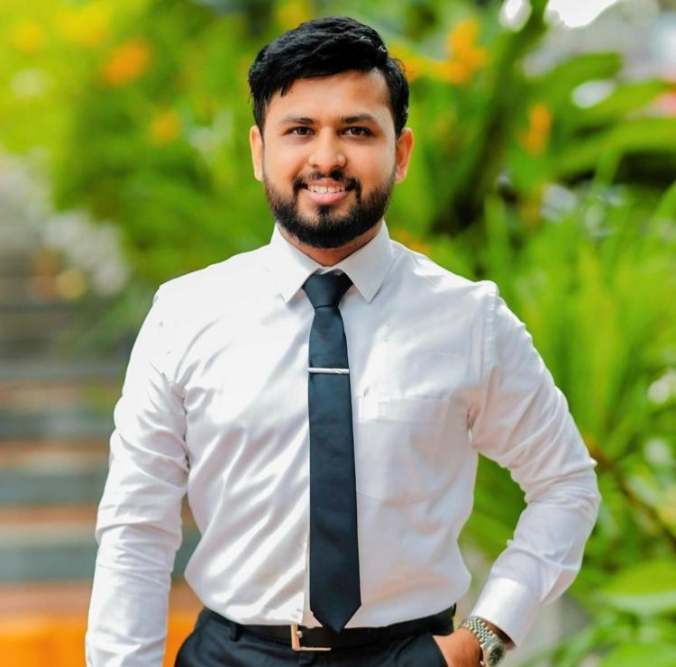
Client Management
Name: Dissanayaka D. M. S. M
Student ID: IT20145552
ITP24R_B1_W22

Slide 20
Client Management
Functional Requirements
Client Account Management
Client Information Management
Client Requirement Documentation
Client Feedback and Interaction
IT20145552 | Dissanayaka D. M. S. M

Slide 21
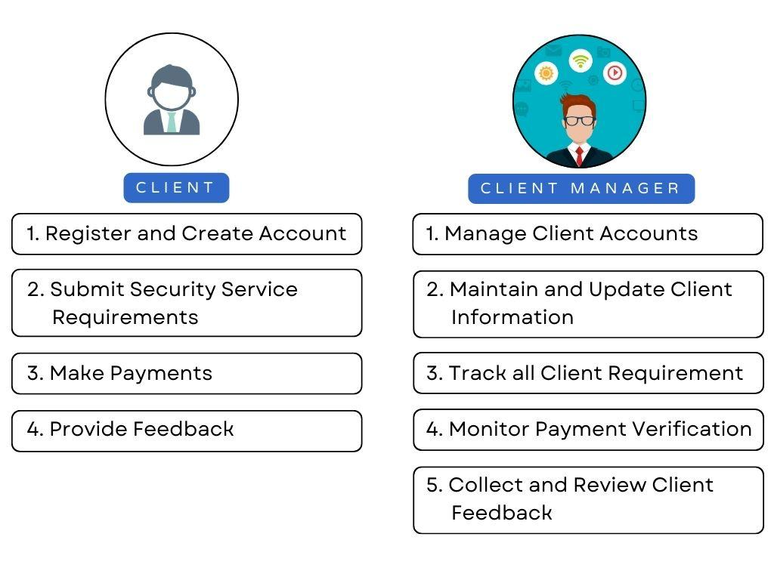
Client Management
IT20145552 | Dissanayaka D. M. S. M

Slide 22
Client Management
Non-Functional Requirements
Security
Usability
Scalability
Compliance
24/7 Availability
IT20145552 | Dissanayaka D. M. S. M

Slide 23
Client Management
Evaluation Methods
Client Account Verification
Client Data Accuracy Testing
Requirements Capture Testing
Feedback Collection Testing
IT20145552 | Dissanayaka D. M. S. M

Slide 24

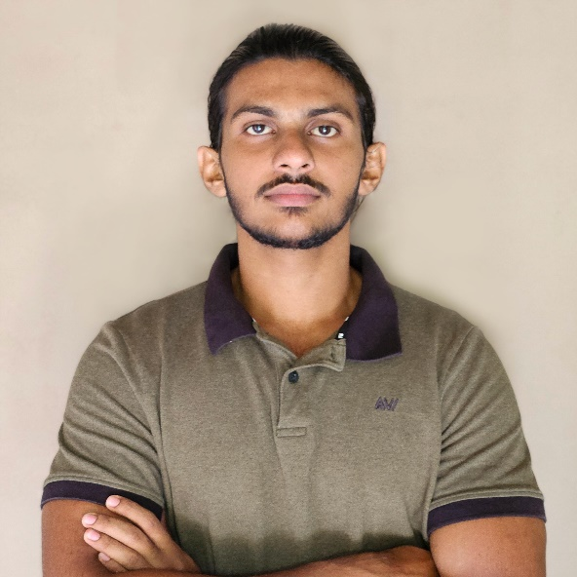
Booking Management
Name: Randiw E. Y
Student ID: IT22257086
ITP24R_B1_W22

Slide 25
Booking Management
Functional Requirements
Event Booking Management
Booking Confirmation
Booking Modification and Cancellation
Booking History and Reporting
IT22257086 | Randiw E. Y

Slide 26


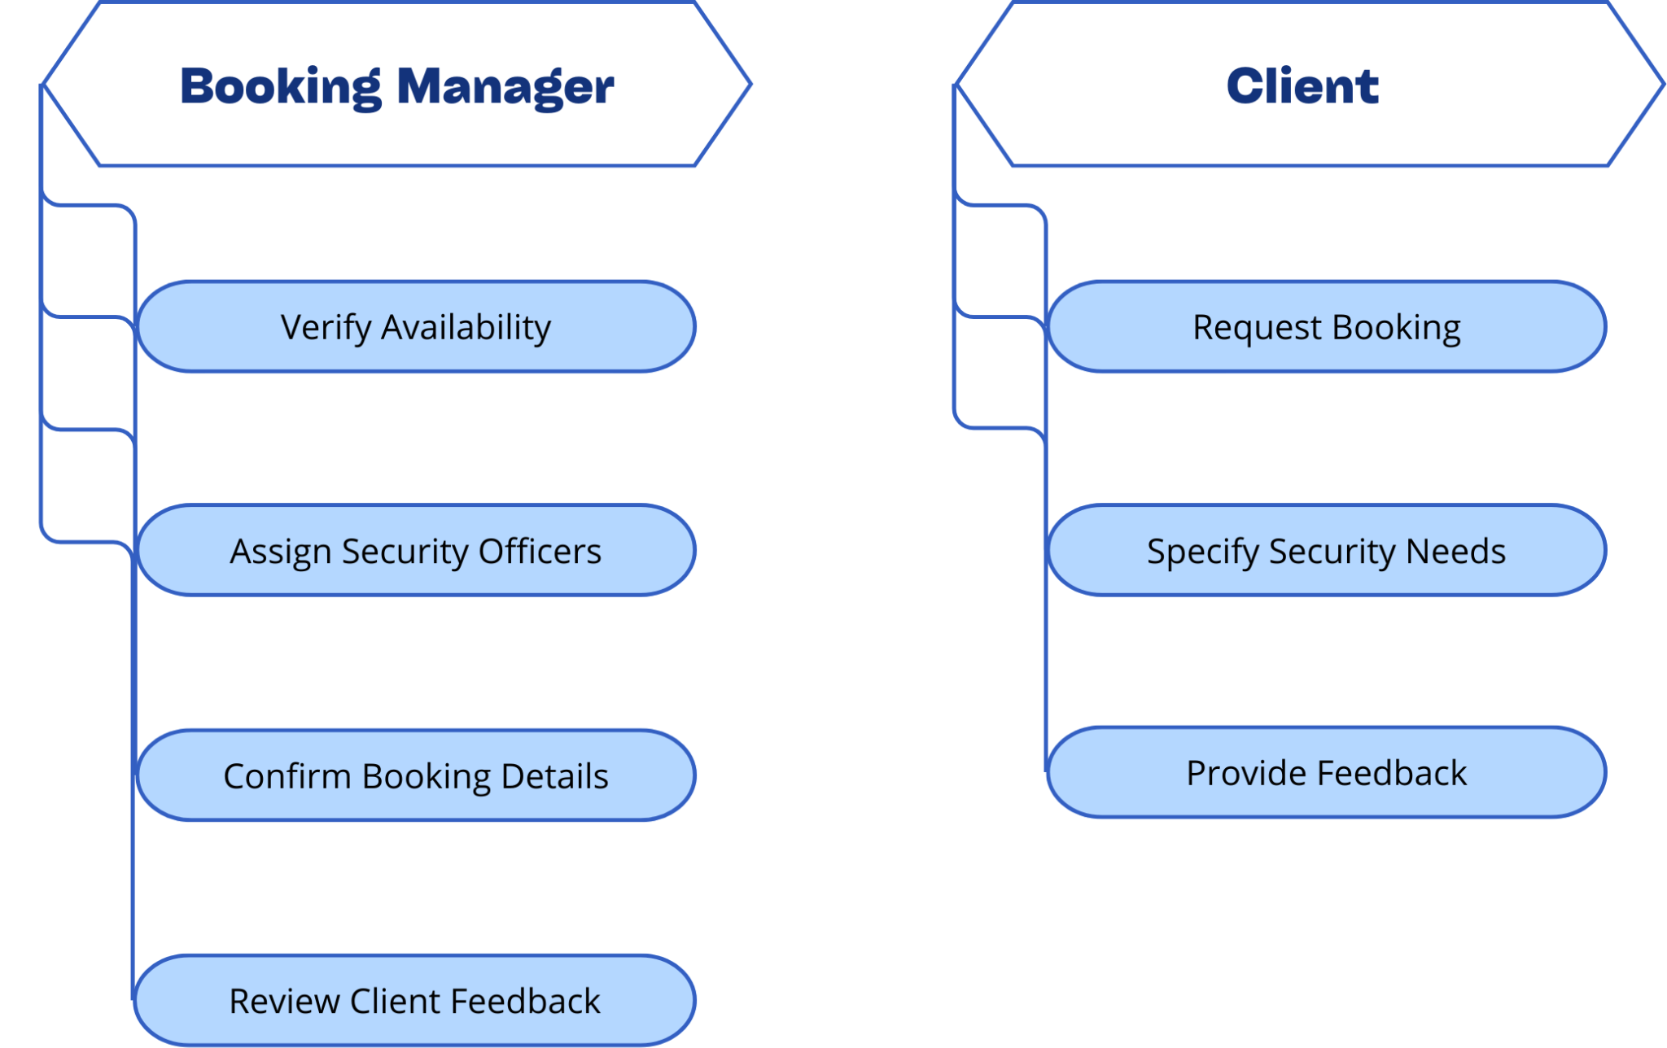
Booking Management
IT22257086 | Randiw E. Y

Slide 27
Booking Management
Non-Functional Requirements
Reliability
Usability
Scalability
Availability
Data Integrity
IT22257086 | Randiw E. Y

Slide 28
Booking Management
Evaluation Methods
Performance Testing
System Availability Monitoring
Scalability Testing
Data Accuracy Checks
IT22257086 | Randiw E. Y

Slide 29

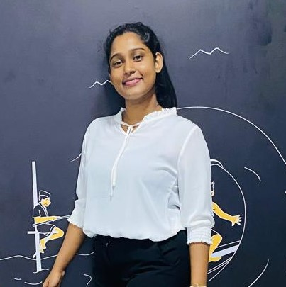
Payment Management
Name: Jayodhya J. D. H
Student ID: IT22293480
ITP24R_B1_W22

Slide 30
Payment Management
Functional Requirements
Invoice Generation
Payment Status Checking
Payment Confirmation
Financial Report Generation
IT22293480 | Jayodhya J. D. H

Slide 31



Payment Management
Process Overview
Payment manager
Booking Manager
Client
Invoice Generation
Payment Status Checking
Payment Confirmation
Financial Report Generation
payment verification
Make a payment
IT22293480 | Jayodhya J. D. H

Slide 32
Payment Management
Non-Functional Requirements
Performance
Usability
Reliability
Scalability
IT22293480 | Jayodhya J. D. H

Slide 33
Payment Management
Evaluation Methods
Performance Testing
Usability Testing
Accuracy Verification
Security Assessment
IT22293480 | Jayodhya J. D. H

Slide 34

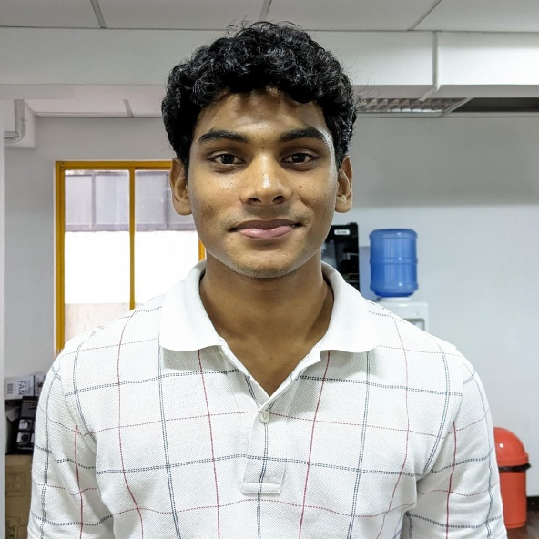
Operation Management
Name: Medawatte W. W. M. T. N. B
Student ID: IT22127082
ITP24R_B1_W22

Slide 35
Operation Management
Functional Requirements
Service Scheduling and Coordination
Service Tracking and Reporting
Incident Management
Resource Management
IT22127082 | Medawatte W. W. M. T. N. B

Slide 36

Operation Management
Process Overview
Check security officers status
Manage deployment
Handle incidence and issues
View and update schedule
Communicate with security officers
IT22127082 | Medawatte W. W. M. T. N. B

Slide 37
Operation Management
Non-Functional Requirements
Performance - System should process within 2 Seconds
Reliability - Uptime and Backups
Data Protection - Sensitive operational data should be encrypted
Accessibility - System should be accessible from various devices
IT22127082 | Medawatte W. W. M. T. N. B

Slide 38
Operation Management
Evaluation Methods
Performance Testing
Security Assessment
Availability and Support Evaluation
Feedback Collection
IT22127082 | Medawatte W. W. M. T. N. B

Slide 39

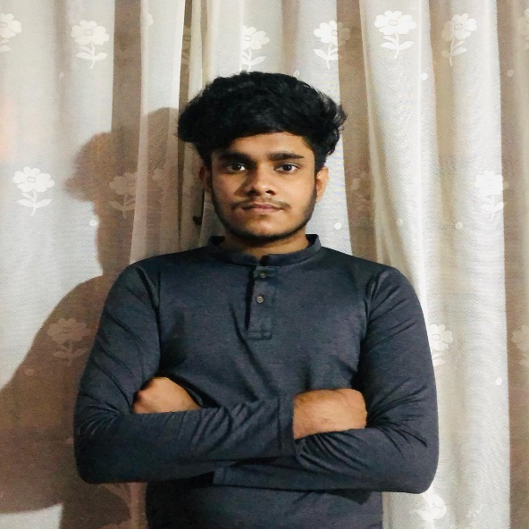
Inventory Management
Name: Kusumsiri P. A. S. S
Student ID: IT22132628
ITP24R_B1_W22

Slide 40
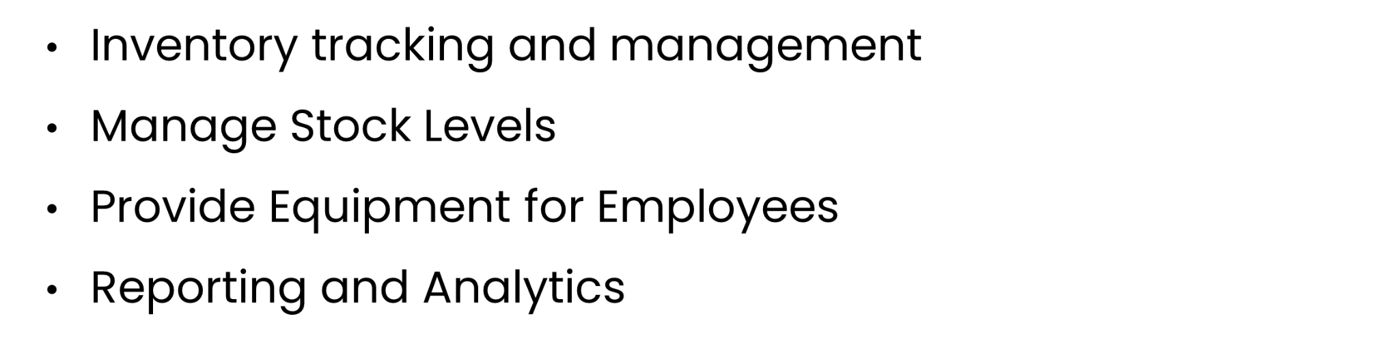
Inventory Management
Functional Requirements
IT22132628 | Kusumsiri P. A. S. S

Slide 41

Inventory Management
Process Overview
Inventory Manager
Create Equipment Record
Read Equipment Record
Update Equipment Record
Delete Equipment Record
Generate Inventory Report
Employee
Receive Equipments
IT22132628 | Kusumsiri P. A. S. S

Slide 42
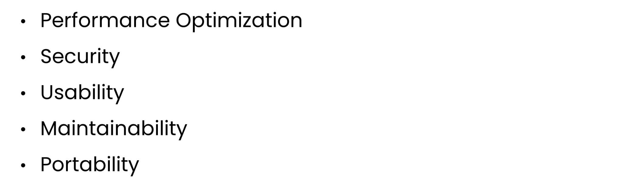
Inventory Management
Non-Functional Requirements
IT22132628 | Kusumsiri P. A. S. S

Slide 43
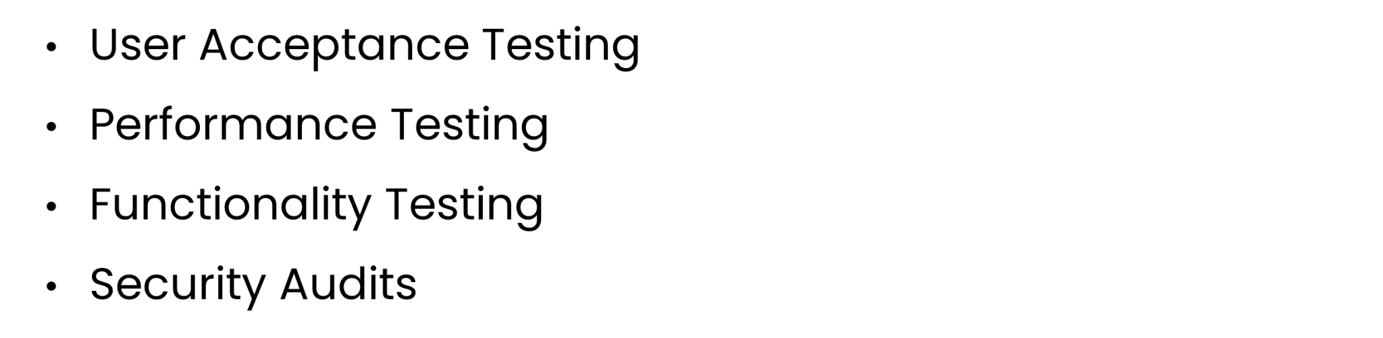
Inventory Management
Evaluation Methods
IT22132628 | Kusumsiri P. A. S. S

Slide 44

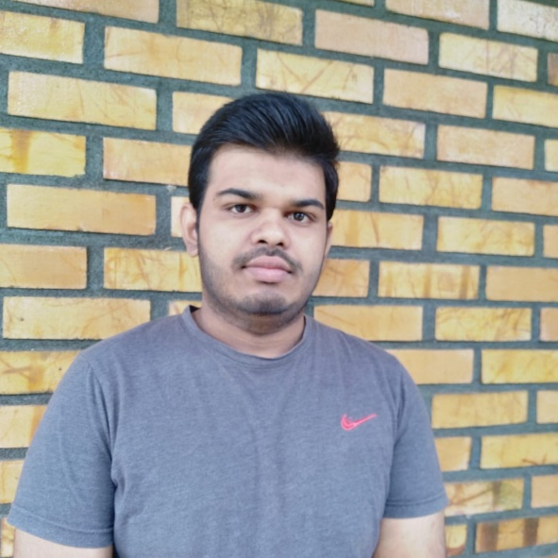
Supplier Management
Name: Ranasinghe R. A. R. V. C
Student ID: IT22197146
ITP24R_B1_W22

Slide 45
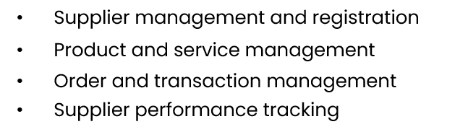
Supplier Management
Functional Requirements
IT22197146 | Ranasinghe R. A. R. V. C

Slide 46
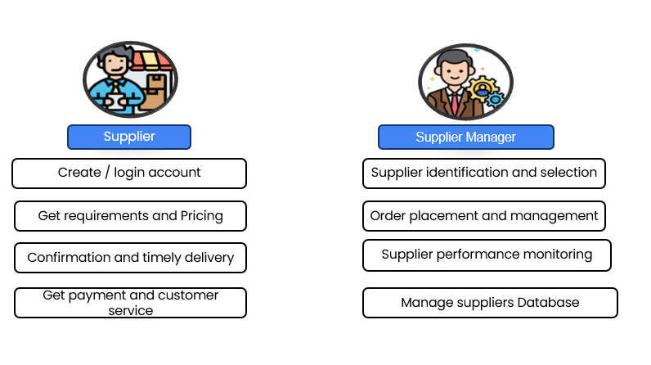
Supplier Management
IT22197146 | Ranasinghe R. A. R. V. C

Slide 47
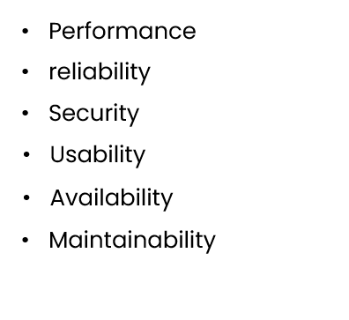
Supplier Management
Non-Functional Requirements
IT22197146 | Ranasinghe R. A. R. V. C

Slide 48
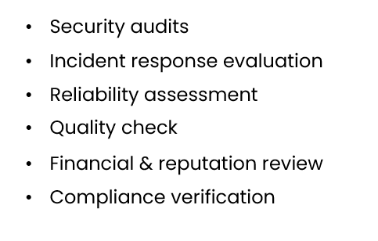
Supplier Management
Evaluation Methods
IT22197146 | Ranasinghe R. A. R. V. C

Slide 49
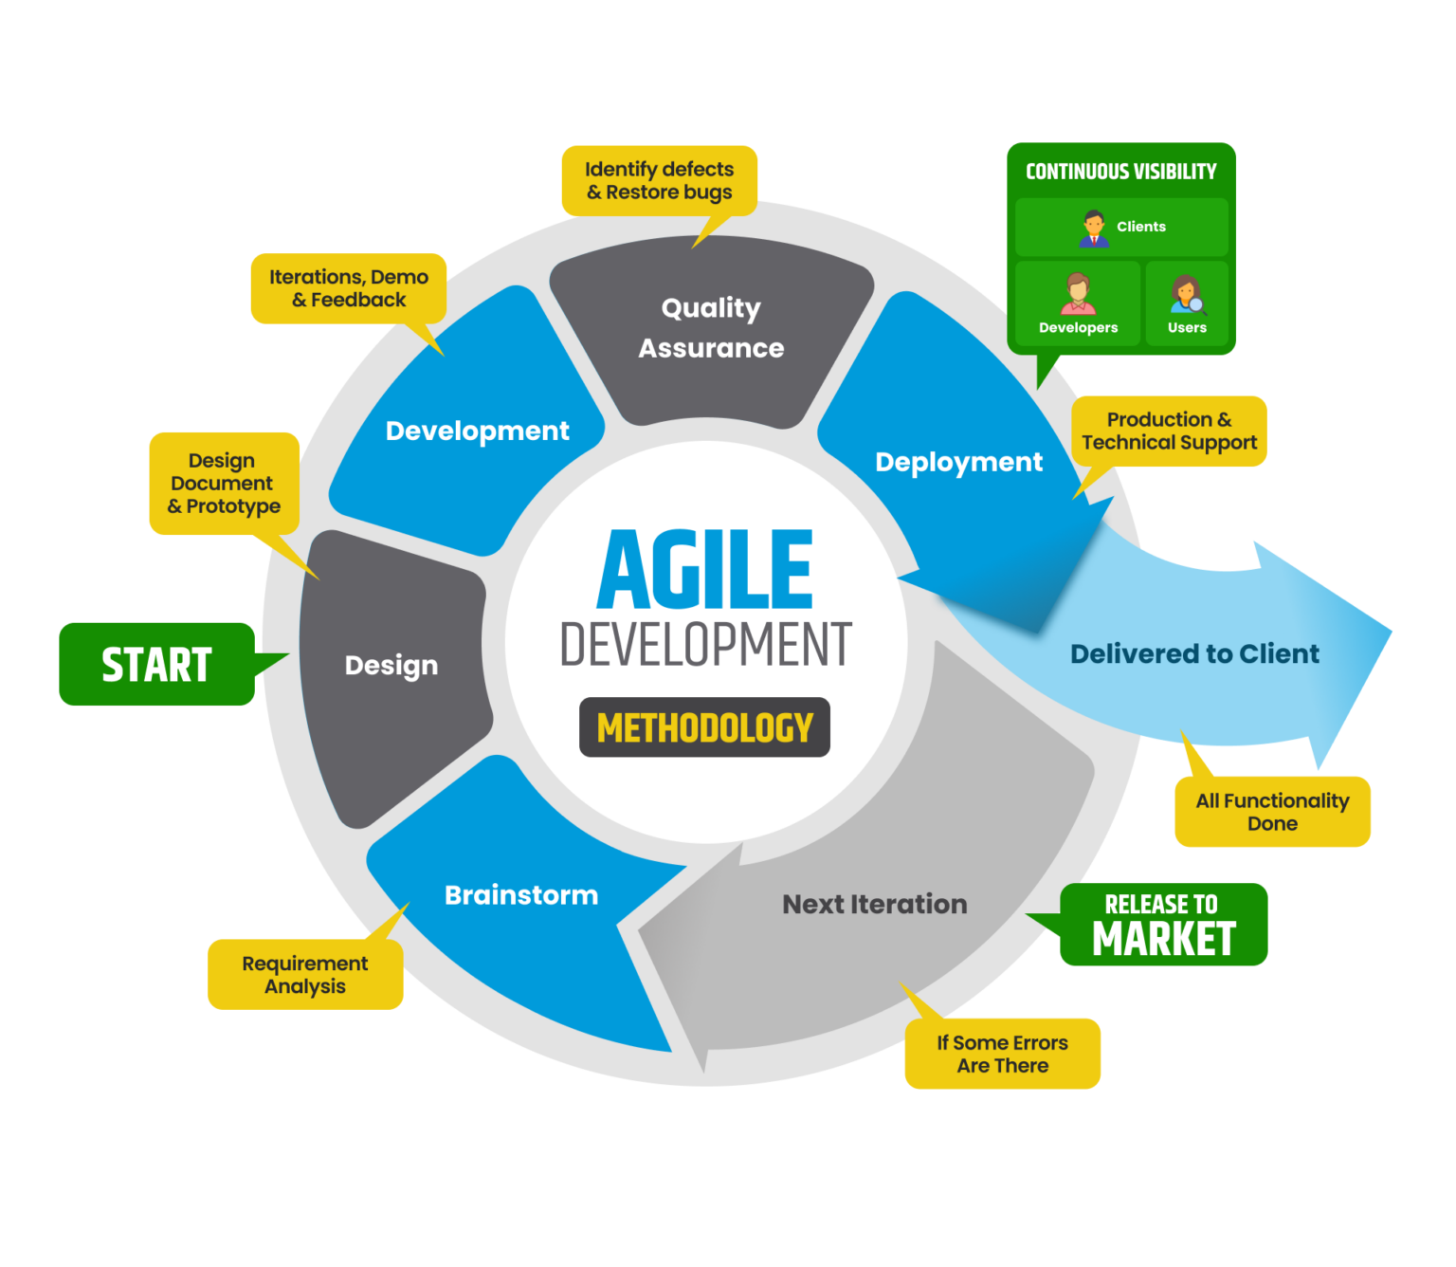
Methodology
Our Security Service Management System development follows the Agile methodology.
Agile is an iterative and incremental approach that emphasizes flexibility, collaboration, and customer satisfaction.
ITP24R_B1_W22

Slide 50




Tools & Technologies
MERN Stack
Visual Studio Code
MERN is a free and open-source JavaScript stack for building dynamic website
Powerful and simple IDE for work with MERN Stack
GitHub
ChatGPT
GitHub is cloud based version controller. Mainly use to collaborate our code.
ChatBot was developed by Open AI. Used to helpful advice for different tasks.
ITP24R_B1_W22

Slide 51
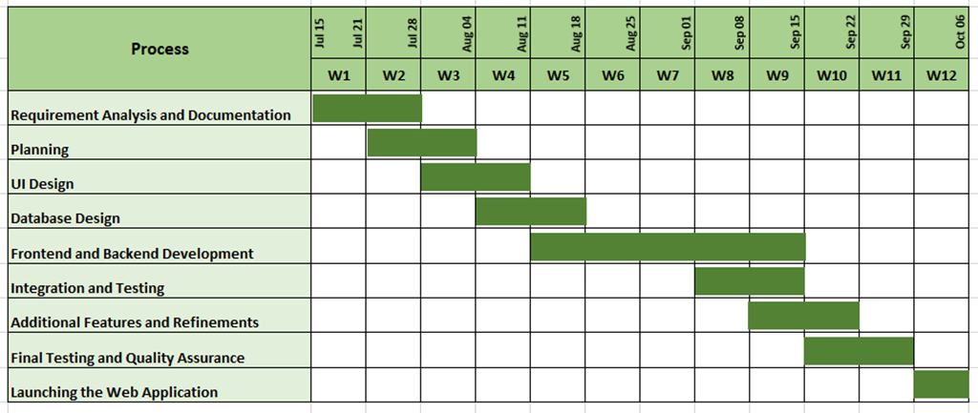
Development Process - Gantt Chart
ITP24R_B1_W22

Slide 52





Our Team
Fernando K. K. C
IT22325228
Sadisha R. M. M
IT22907998
Dissanayaka D. M. S. M
IT 20145552
Randiw E. Y
IT22257086
Jayodhya J. D.H
IT22293480
Medawatte W. W. M. T. N. B
IT22127082
Kusumsiri P. A. S. S
IT22132628
Ranasinghe R. A. R. V. C
IT22197146
ITP24R_B1_W22

Slide 53
Thank You !
For Your Attention
ITP24R_B1_W22

